Slide 1

Computer Programming for Engineers
Week 7 Lecture 2
Oct. 13, 2022
Lecturer: Mohammad Mahdi Javidan
College of Engineering, Sungkyunkwan University
Fall Semester 2022

Slide 2


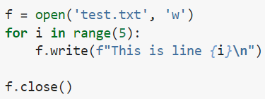

Reading and Writing Data
TXT files
Table. Modes
 | r | r+ | w | w+ | a | a+
Read | * | * |  | * |  | *
Write |  | * | * | * | * | *
Create |  |  | * | * | * | *
Truncate |  |  | * | *
Position at start | * | * | * | *
Position at end |  |  |  |  | * | *
Truncate means delete the content of the file
College of Engineering, Sungkyunkwan University

Slide 3
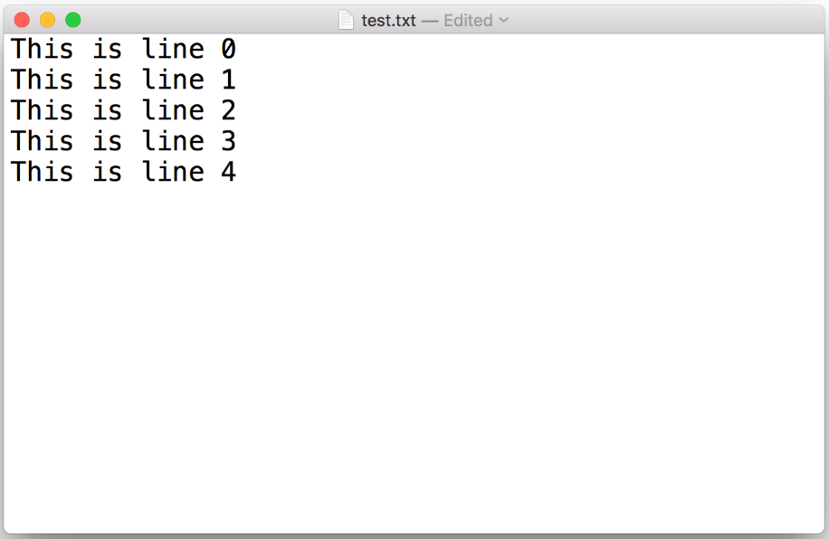
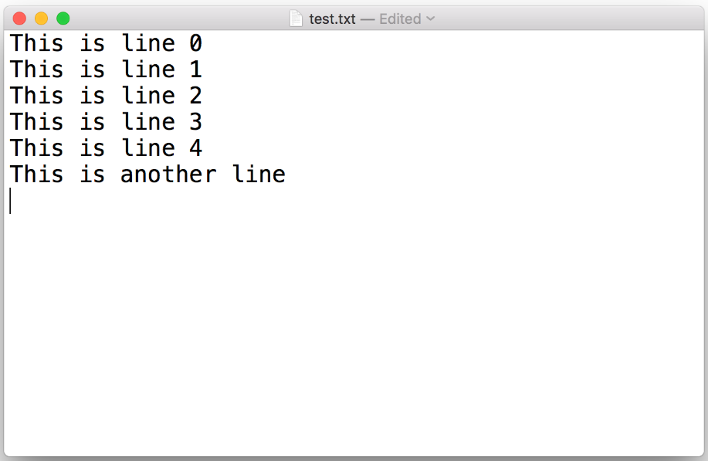
TXT Files
College of Engineering, Sungkyunkwan University

Slide 4
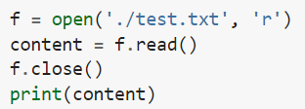
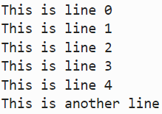


TXT Files
Reading a file content and storing it in a variable
College of Engineering, Sungkyunkwan University

Slide 5
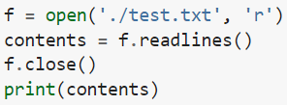


TXT Files
Reading the content line by line
College of Engineering, Sungkyunkwan University

Slide 6





TXT Files
Dealing with numbers and arrays
Dealing with numbers and arrays
College of Engineering, Sungkyunkwan University

Slide 7
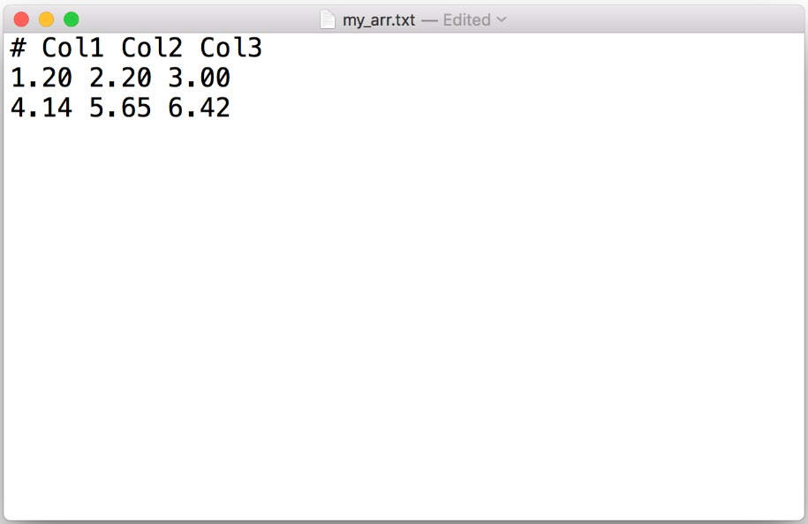
TXT Files
College of Engineering, Sungkyunkwan University

Slide 8

CSV Files
CSV stands for comma-separated values
There is a python CSV module
The numpy module is used here
College of Engineering, Sungkyunkwan University

Slide 9
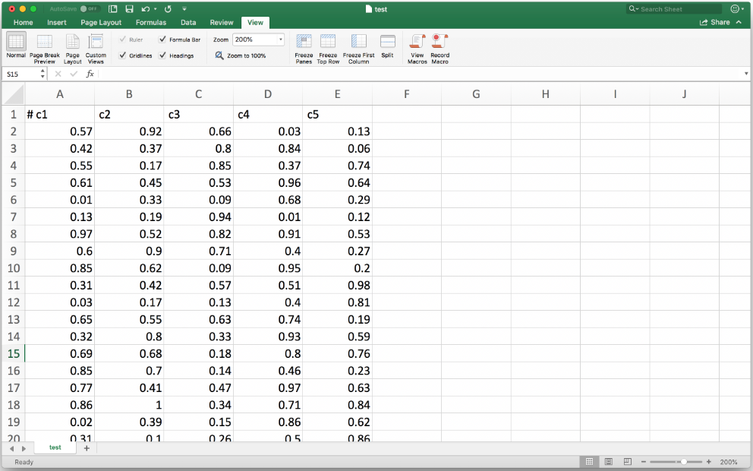
CSV Files
College of Engineering, Sungkyunkwan University

Slide 10
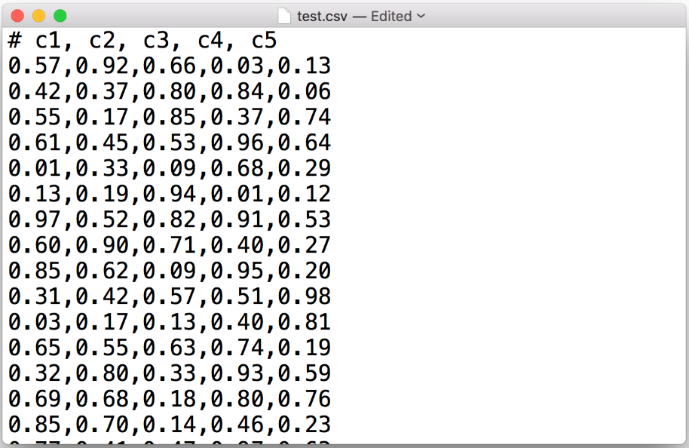
CSV Files
College of Engineering, Sungkyunkwan University

Slide 11



PICKLE Files
Convenient for storing any data type which serializes the data and save it in the binary format
1st argument: object to be serialized
2nd argument: file object
Pickle files are designed specifically for Python users, while csv and txt files can be shared between other programs
College of Engineering, Sungkyunkwan University

Slide 12
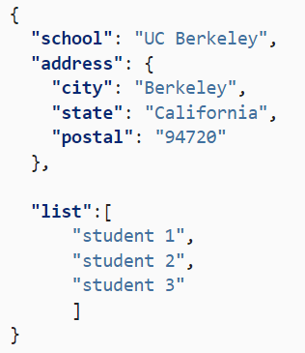
JSON Files
JSON stands for JavaScript Object Notation
Lightweight format for storing and transforming data
Commonly used in web applications and electronic data interchange
Self-describing and easy to understand
Quoted string containing value in key-value pairs within {}
An example JSON file
College of Engineering, Sungkyunkwan University

Slide 13

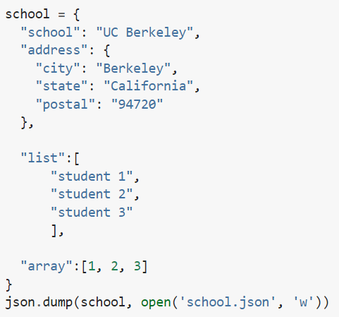
JSON Files
Using JSON is similar to PICKLE
JSON files are not encoded like PICKLE files
College of Engineering, Sungkyunkwan University

Slide 14


JSON Files
Reading JSON files
College of Engineering, Sungkyunkwan University

Slide 15
Assignment 8
Create a list and save it in a text file that each of the item in the list will take one line.
Save the same list in problem 1 to a CSV file.
Create a 2D numpy array, and save it to CSV file and read it back to a 2D array.
Save the same array in problem 2 to a pickle file and load it back.
Create a dictionary and save it to a JSON file.
Create a 1D numpy array, and save it to a JSON file with the key named ‘data’. Then load it back.
College of Engineering, Sungkyunkwan University

